Slide 1
A/B TEST ANALYSIS ON A NEW HOMEPAGE AND ITS EFFECT ON TOTAL REVENUE
Control Group
Treatment Group
3.92%
Conversion Rate
Conversion Rate
4.63%
A
B
24343 users
$82,146 total amount spent by users
955 users made purchase
24600 users
$83,415 total amount spent by users
1139 users made purchase

Slide 2
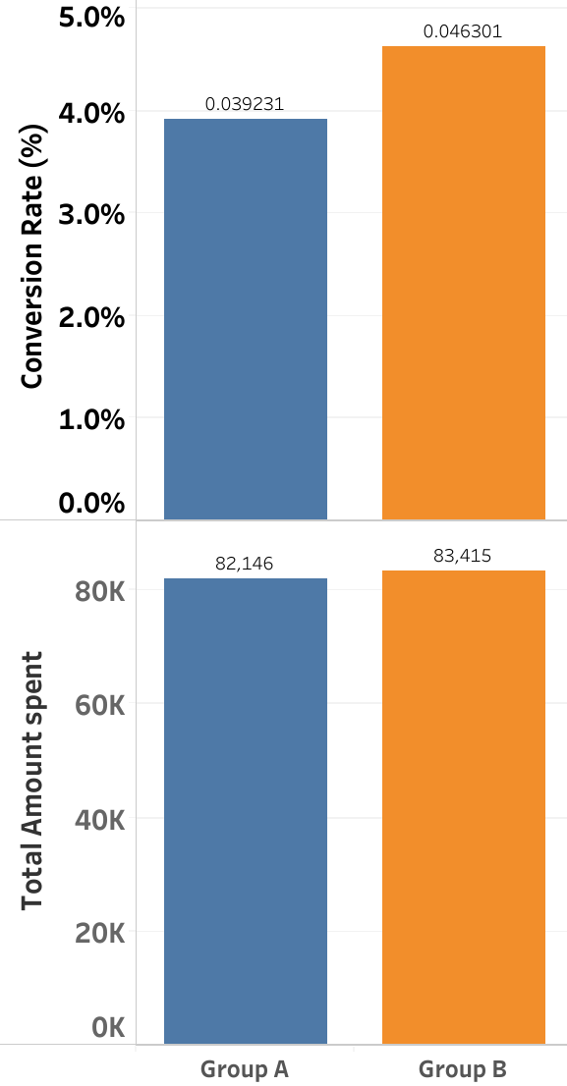
● This Experiment ran for 13 days and users were randomly assigned to each group.
● The total amount spent by customers in group B was higher than group A with $1,269 which led to a 1.5% increase in revenue
● The conversion rate in group B was higher than group A with 0.71%

Slide 3
HIGHLIGHTS OF TESTS AND ANALYSIS CARRIED OUT
1. Hypothesis Testing on the metrics to determine statistical significance and the result are as follows:
Conversion rate: There is significant statistical evidence to show a difference in both groups.
Average Amount spent per user: No significant statistical evidence to show a difference in both groups.
2. A power analysis to help us understand how well our study is equipped to detect meaningful/practical/real life differences between groups and to determine whether we had adequate total number of users in both groups to detect this meaningful difference.
For a difference/effect size of 10% and Power of 80%, we will need:
Conversion rate: A sample size of 70,000
Average Amount spent per user: A sample size of 146, 046
This means we cannot confidently say that we have an 80% chance of detecting a 10% difference between the 2 groups with our current sample size 48,943.

Slide 4
RECOMMENDATIONS
Our recommendation is that the banner should be launched. This is because of the following reasons:
One of the metrics (conversion rate) showed a statically significant increase in the treatment group.
The cost required to launch the banner is not expensive.
We believe this approach strikes a balance between statistical rigor and the need for practical, impactful decision-making.

